Slide 1
Comprehensive Digital Marketing
Project Work
COMPANY:- LAKME
TEAM LEAD- PYLA RAJITHA
TEAM MEMBER P.PRIYANKA
TEAM MEMBER K.JHANSI
TEAM MEMBER-R.PRATHYSHA

Slide 2
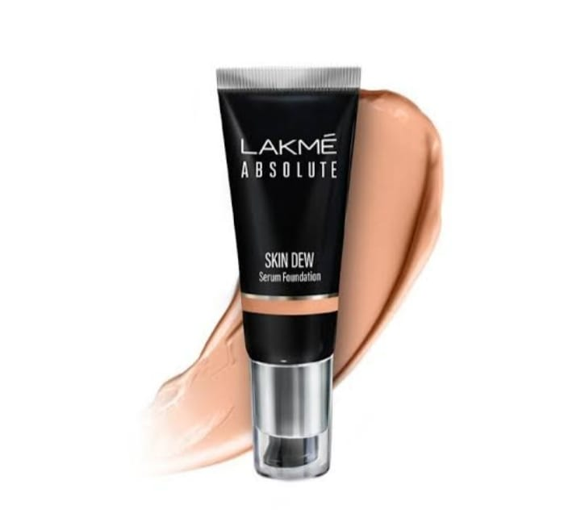

Slide 3
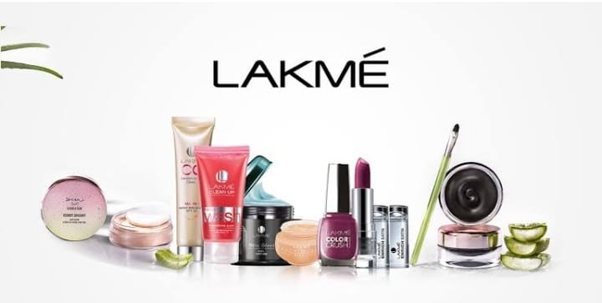
BRAND LOGO
BRAND COLOR: DEEP PINK

Slide 4
Part 1: Brand study, Competitor Analysis & Buyer’s/Audience’s Persona
Research Brand Identity: Study the brand's mission, values, vision, and unique selling propositions (USPs).
Mission: An Ally To The Classic Indian Woman, Lakme Inspires Her To Express The Unique Beauty And Sensuality Within Enabling Her To Realize The Potency Of Her Beauty.
Vision: Lakme products touch the lives of over 2billion people every day whether that’s through feeling great.
USP(Unique selling propositions): Lakme brings expert products and services that are borne out of true understa...

Slide 5
Part 1: Brand study, Competitor Analysis & Buyer’s/Audience’s Persona
Analyze Brand Messaging: Traditional and Beautiful.
Examine the brand's tagline: Lakme Reinvent; Beauty Sutra; Inspired haircare.

Slide 6

Competitor Analysis: Select three competitors operating in the same industry or niche as the chosen brand, examine their USPs and online communication.
Competitor 1:L’Oreal is a French personal care company headquartered in clichy, Hauts-de-Seine, with a registered office in paris.
L’Oreal (brand value up 10% to US$11.2 billion) remains the world’s most valuable cosmetics brand.
https://www.lorealparis.co.in/
/
Part 1: Brand study, Competitor Analysis & Buyer’s/Audience’s Persona

Slide 7

Competitor 2: MCA cosmetics is named one of the top three global makeup brands, with an annual turnover of over $1 billion, and 500 independent stores, with over thirty stores in France. MAC Cosmetics Mission Statement. ‘’All Races, All Sexes, All Ages’’ conceived to embrace all consumers. To be the worlds leading make-up authority... https://www.maccosmetics.in/

Slide 8

Competitor 3: Revlon, Inc. is an American multinational company dealing in cosmetics, skin care, perfume, and personal care.
Revlon, Inc. is an American multinational company dealing in cosmetics, skin care, perfume, and personal care.
https://revlon.co.in/

Slide 9
Part 1: Brand study, Competitor Analysis & Buyer’s/Audience’s Persona
Buyer's/Audience's Personal info : Lakmé has managed to engage its primary target audience: girls and women, throughvariousactivitiesthatseemtocatch their fancy.
Demographics: Lakme targeted women from the age group 24-42 in this section and are now targeting young women. 2. Geographic: It focuses primarily on the production of urban products.
Psychographics : which refers to the customer group’s lifestyle. For example, their social class lifestyle, Personality, Opinions and attitudes of their females.

Slide 10
Behaviours: The marketers try to understand the actions of the consumers in the marketplace and the underlying motives for such actions. These motives are the factors that influence the consumer behavior. These are
Psychological Factors: The human psychology plays a crucial role in designing the consumer’s preferences and likes or dislikes for a particular product and services. Some of the important psychological factors are
Motivation
Perception
Learning
Attitudes and Beliefs

Slide 11
Cultural Factors: It is believed that an individual learns the set of values, perceptions, behaviors, and preferences at a very early stage of his childhood from the people especially, the family and the other key institutions which were around during his developmental stage. Thus, the behavioral patterns are developed from the culture where he or she is brought up. Several cultural factors are:
Culture
Subculture
Social class

Slide 12
Interests: Lakmé is the country's first cosmetic brand to introduce makeup to Indian women and takes pride in being the Indian beauty expert for over 65 years.It is a complete beauty brand spanning colour cosmetics & skin care and extends to beauty services through the network of Lakmé Salons.Its bond with beauty and fashion is manifested through the Lakmé Fashion Week, which is now the largest fashion event of its kind in the country.

Slide 13
Part 2: SEO & Keyword Research
SEO Audit :Top lakmeindia.com Audience Interests
Audience interests reveal key details on the browsing interests of lakmeindia.com's visitors. lakmeindia.com's audience is interested in Computers Electronics and Technology > Social Media Networks & community.
Audience composition can reveal a site's current market share across various audiences. lakmeindia.com's audience is 40.68% male and 59.32% female. The largest age group of visitors are 18 - 24 year olds .
Keyword Research: Cosmetics, Makeup, Skincare, Beauty, Lipstick, Foundation, Mascara , Eyeliner, Nail polish, Blush, Compact powder, Face wash, Moisturizer, Sunscreen, Kajal.
On page Optimization: On-page optimization in the context of Lakmé, a well-known beauty and cosmetics brand, refers to the process of optimizing their website's individual pages to improve their search engine rankings, user experience, and overall visibility on the internet. It involves making strategic changes and improvements to the website's content, structure, and HTML elements to ensure it is relevant and appealing to both search engines and users. Here are some on-page optimization strategies for Lakmé's website:

Slide 14
KEYWORD RESEARCH
Keyword Research: Conduct thorough keyword research to identify the most relevant and valuable keywords related to Lakmé's products, services, and industry. Use tools like Google Keyword Planner or other SEO keyword research tools to find high-volume, low-competition keywords.
Meta Tags: Optimize the meta title and meta description tags for each page on the website. Include the targeted keywords and make sure they accurately describe the content of the page. Meta tags are essential for search engine results pages (SERPs) and influence click-through rates.

Slide 15
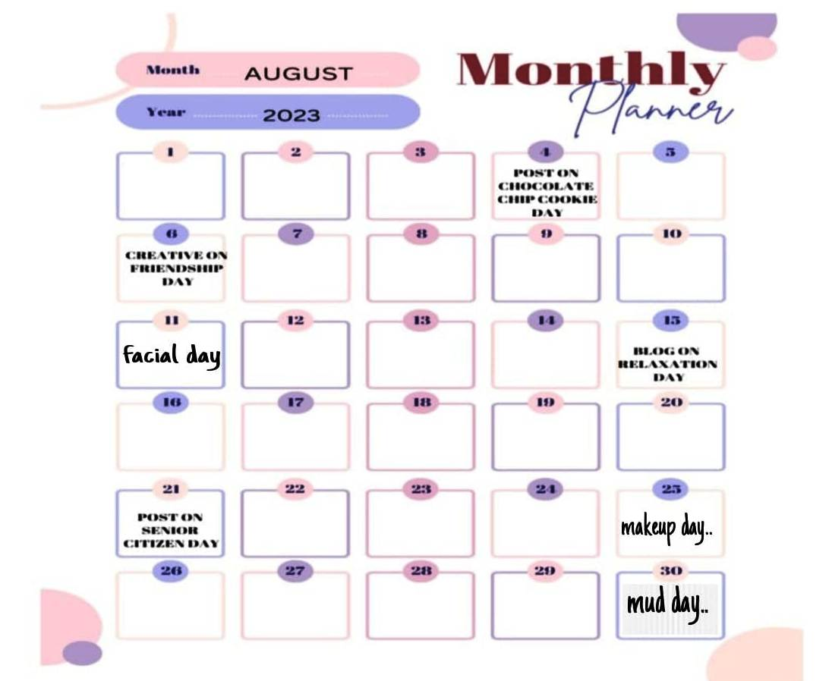
Part 3: Content Ideas and Marketing Strategies

Slide 16
Part 3: Content Ideas and Marketing Strategies
Get the Perfect Look for Every Occasion": Create a series of makeup tutorials and tips using different Lakmé products to achieve various makeup looks for special occasions like weddings, parties, or date nights.
1. "Skincare Routine with Lakmé": Develop a video or blog post featuring a step-by-step skincare routine using Lakmé's skincare products, highlighting the benefits of each product.
2. "Lakmé's Beauty Secrets": Share behind-the-scenes stories or interviews with makeup artists and beauty experts who use Lakmé products to achieve stunning looks on celebrities and models.
3. Summer Glow with Lakmé": Showcase a range of Lakmé products that help achieve a fresh, radiant summer look, featuring sunscreens, BB creams, and vibrant lip colors.
4. "Winter Skincare with Lakmé": Highlight Lakmé's winter skincare essentials to combat dryness and keep skin hydrated during the colder months.

Slide 17
5. "Lakmé for All Skin Types": Create content showcasing Lakmé products suitable for various skin types, including oily, dry, sensitive, and combination skin.
6. "Lakmé's Colorful Range of Lipsticks": Introduce Lakmé's extensive collection of lipsticks, featuring swatches and reviews of different shades and finishes.
7. "Flawless Finish with Lakmé Compact Powders": Demonstrate how Lakmé compact powders can help set makeup and achieve a flawless finish.
8. Lakmé's Iconic Products Through the Years": Take a trip down memory lane by showcasing Lakmé's iconic products that have stood the test of time and remain popular to this day.

Slide 18
9. “Makeup Essentials for Beginners": Create a starter kit guide with Lakmé products for makeup beginners, including essential products and tools needed to get started.
10. "Lakmé's Bridal Collection": Feature the specialized bridal makeup range from Lakmé, demonstrating how to create a stunning bridal look using these products.
11. "Get the Look of Your Favorite Celebrity with Lakmé": Analyze the makeup styles of popular celebrities and create tutorials on how to achieve their signature looks using Lakmé products.
12. "Lakmé for Men: Grooming Essentials": Address the growing market for men's grooming products by showcasing Lakmé's range of skincare and grooming products for men.
13. The Science behind Lakmé Skincare": Highlight the research and technology that goes into developing Lakmé's skincare products, emphasizing their effectiveness and quality.

Slide 19
PART 4: CONTENT CTREATION AND CURATION Format 1: BLOG ARTICLE Lakme's commitment to innovation and quality has made it a household name across the country. From its early days, the brand has focused on understanding the unique beauty requirements of Indian women and crafting products tailored to their skin tones and textures. This approach sets Lakme apart from many international brands and has been instrumental in its enduring success.The brand's product line includes an array of makeup essentials, skincare solutions, and beauty accessories. Lakme's cosmetic range boasts an impressive selection of lipsticks, foundations, eyeliners, mascaras, and eyeshadows, catering to every makeup enthusiast's desires. What sets Lakme apart is its dedication to creating products suitable for various occasions, from everyday wear to festive celebrations.Lakme's skincare offerings are equally impressive, featuring gentle yet effective formulations to address various skin concerns.. Beyond its product range, Lakme has actively promoted beauty and empowerment through various initiatives. The brand has been associated with the prestigious Lakme Fashion Week, providing a platform for emerging designers and celebrating the diversity of Indian fashion.

Slide 20
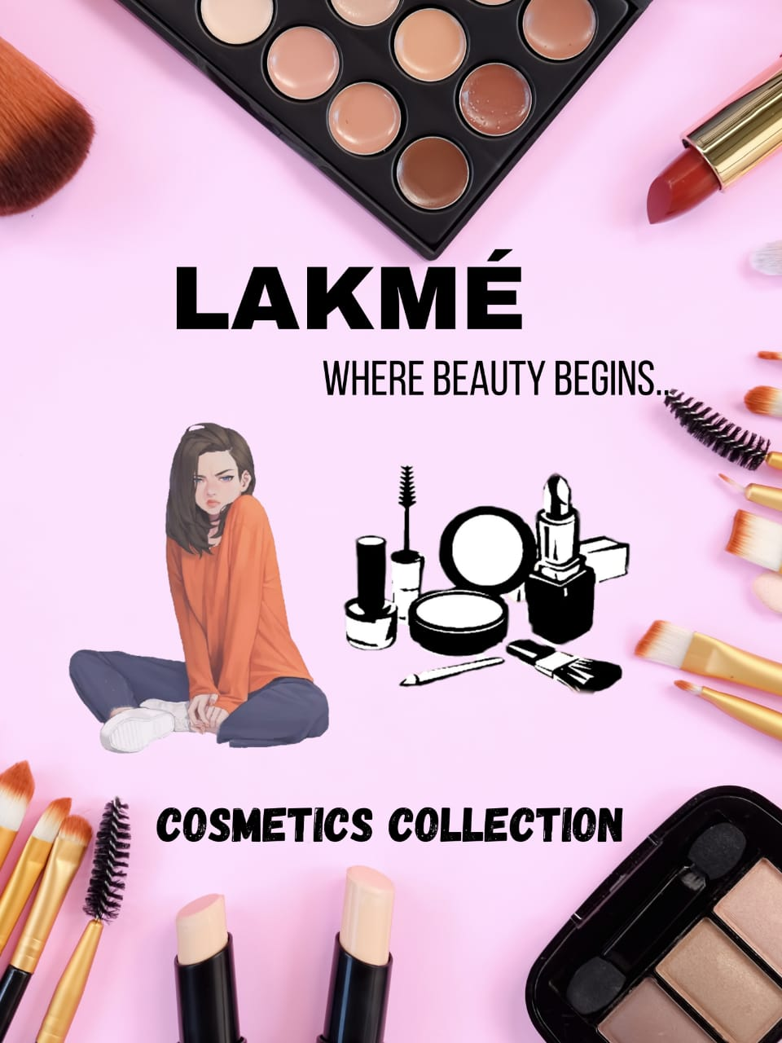
FORMAT -2

Slide 21
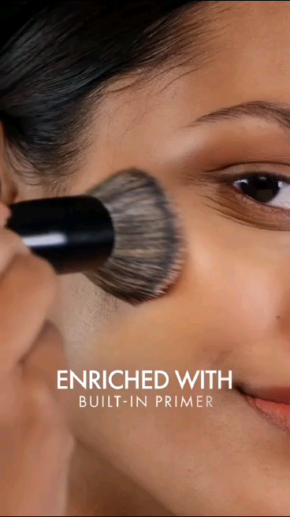
FORMAT 3 VIDEO EDITING
https://drive.google.com/file/d/1qX80wVSeZywS_CFvjpX6jfr07Vr1EKWW/view?ts=64c23158&pli=1

Slide 22
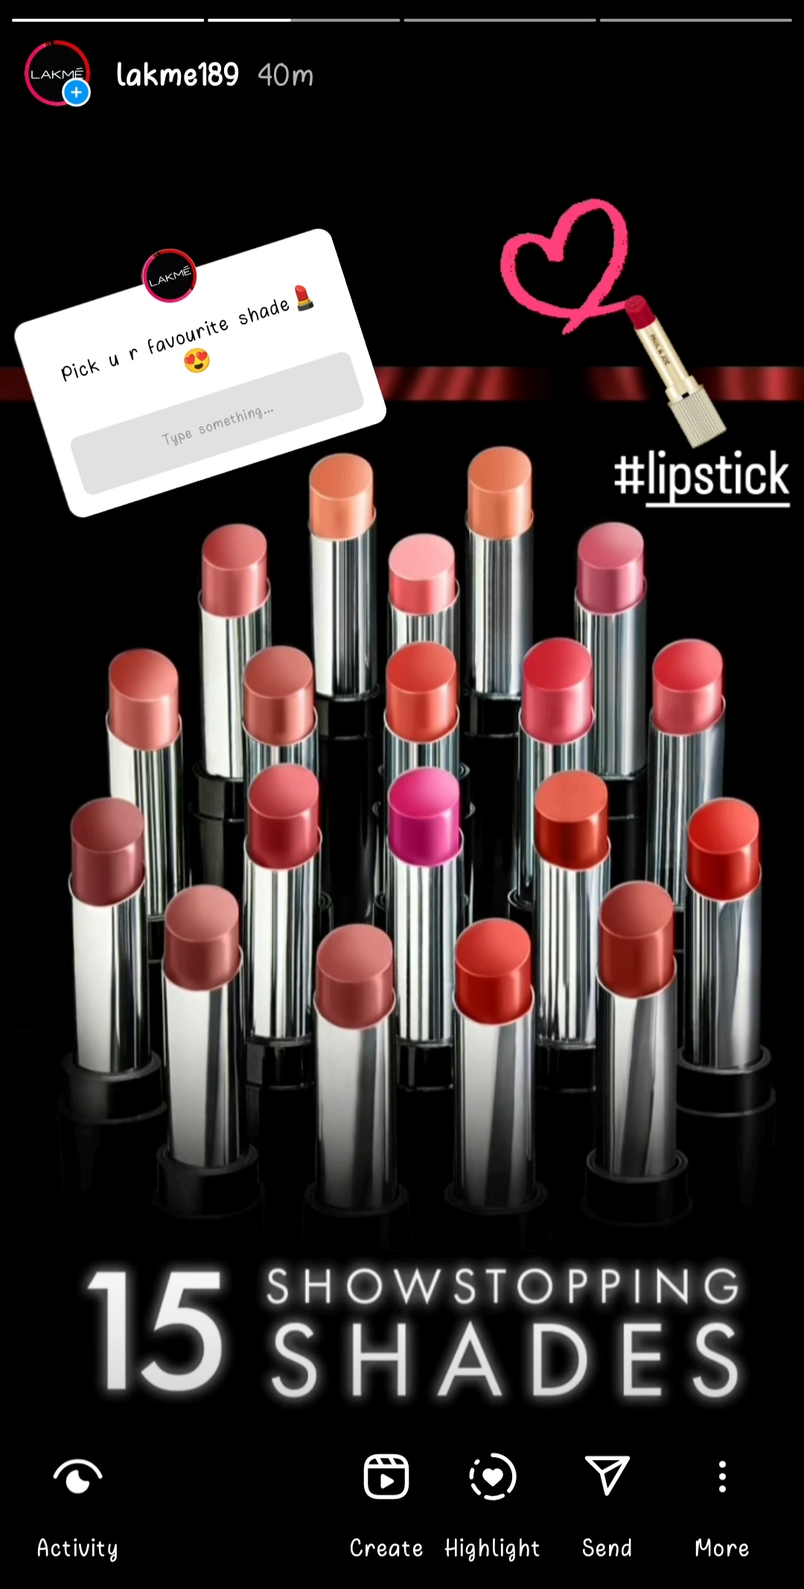
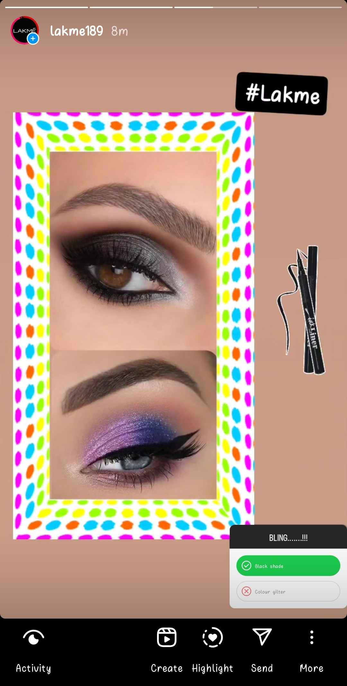
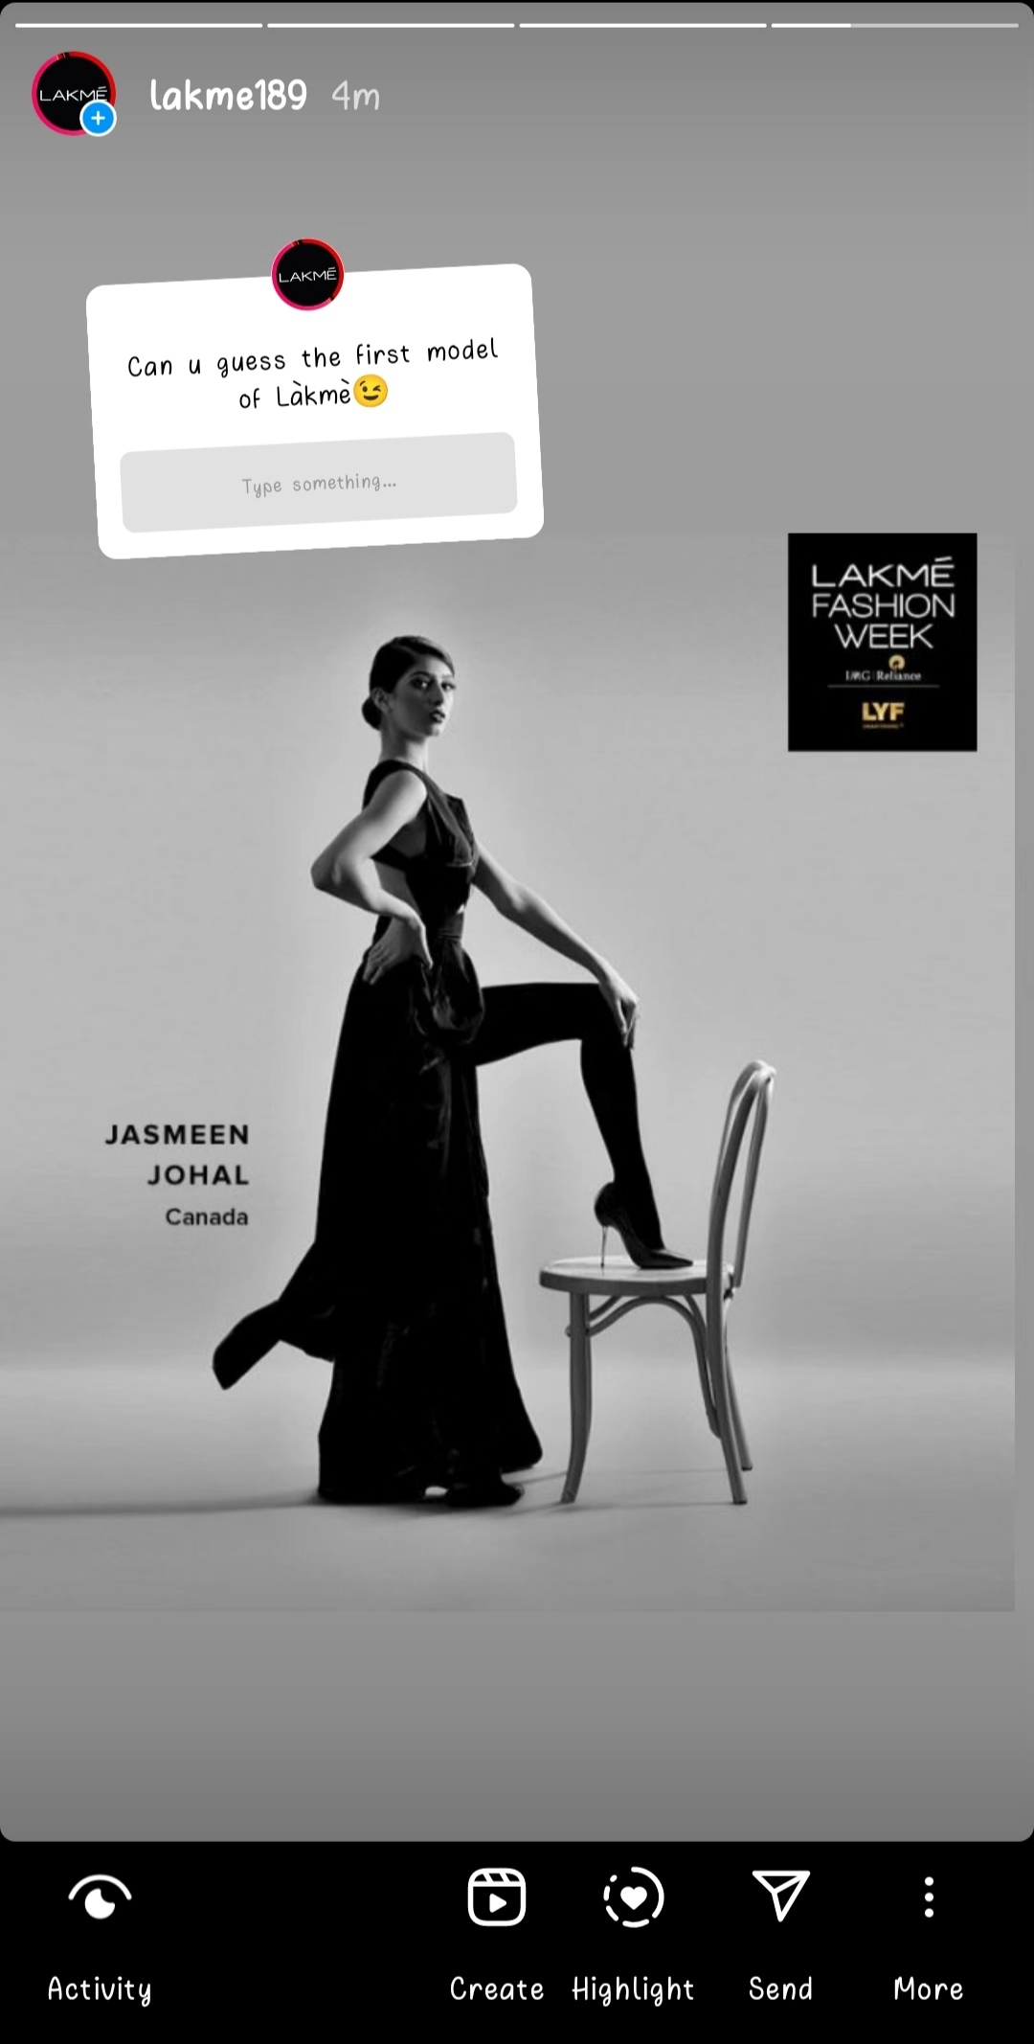
Part 4: Content Creation and Curation (Post creations, Designs/Video Editing, Ad Campaigns over Social Media and Email Ideation and Creation)
Instagram Story
REACH- 18
IMPRESSIONS-6
REACH-21
IMPRESSIONS-8

Slide 23
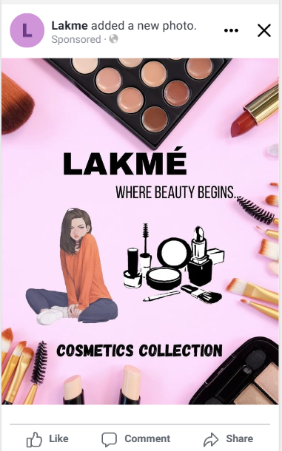
Meta Ad Campaigns
FACEBOOK ADS MANAGER
BRAND AWARENESS

Slide 24
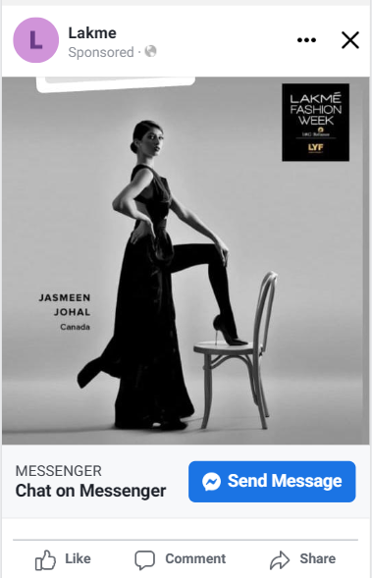
FACEBOOK AD MANAGER
GENERATING LEADS

Slide 25
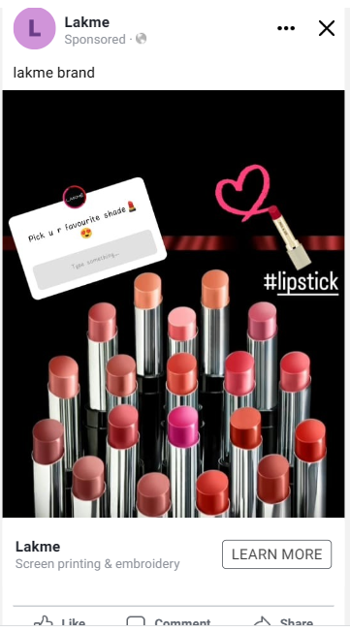
FACEBOOK ADS MANAGER
CREATING WEB TRAFFIC

Slide 26
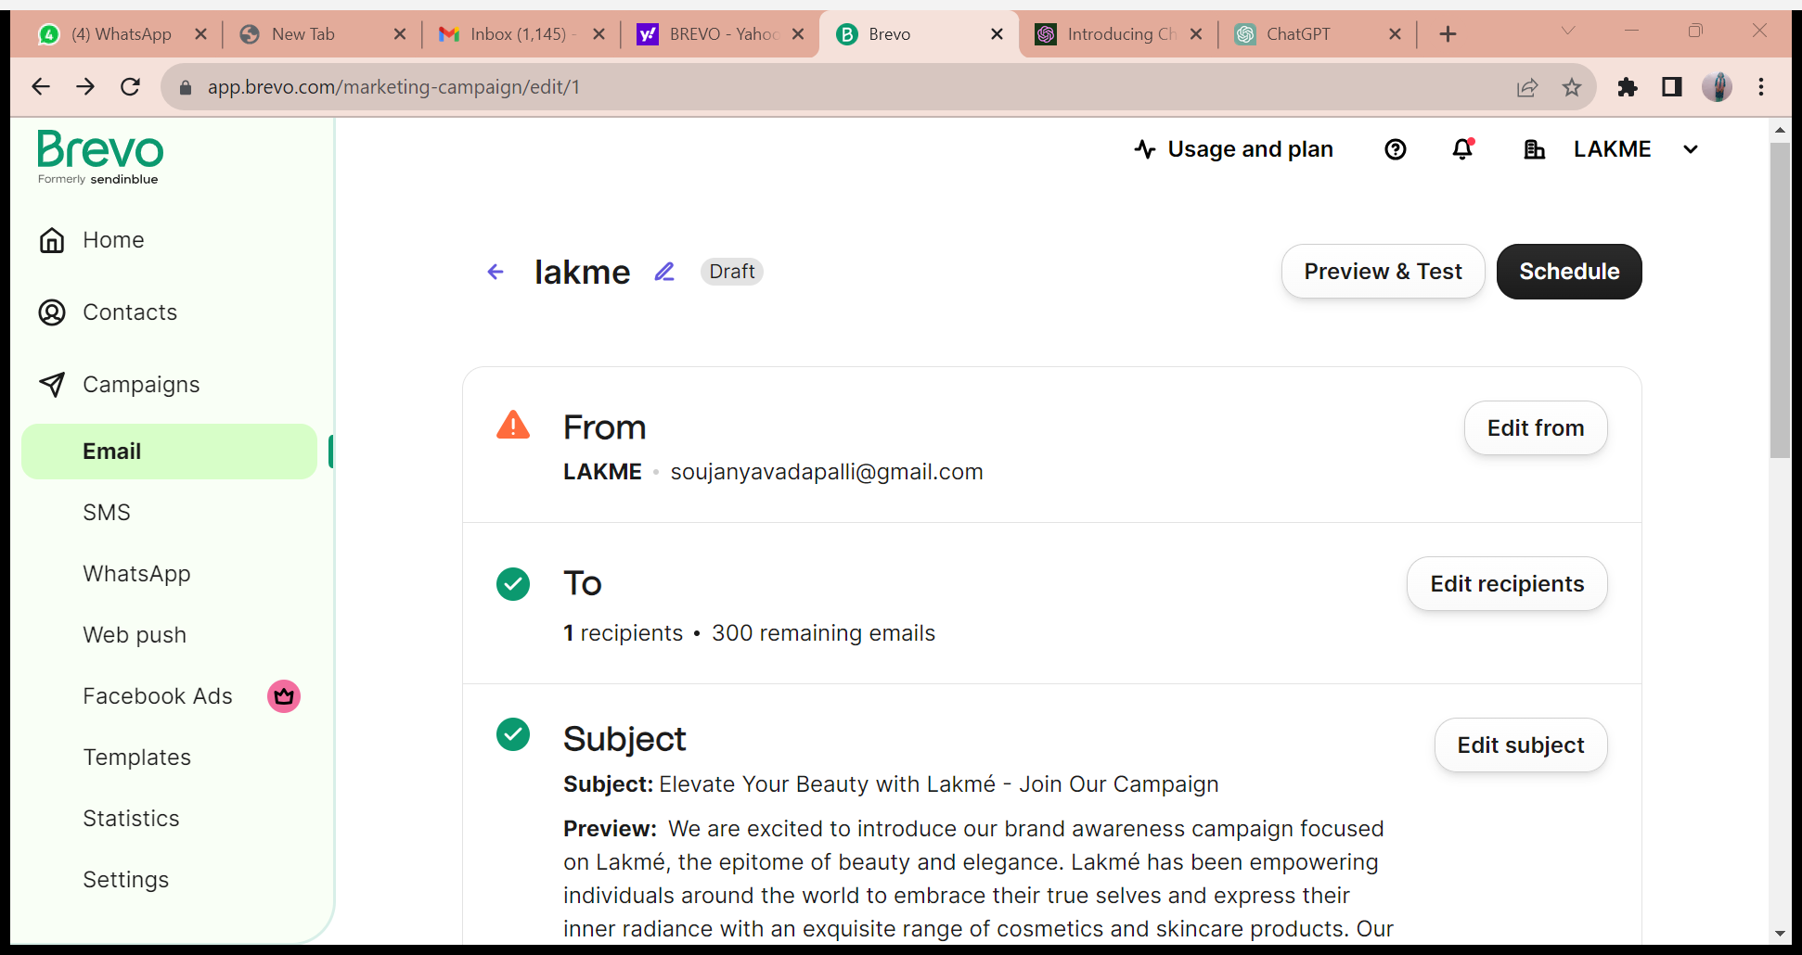
Email Ad Campaign 1- Lead Generation

Slide 27
THANK YOU

